Slide 1
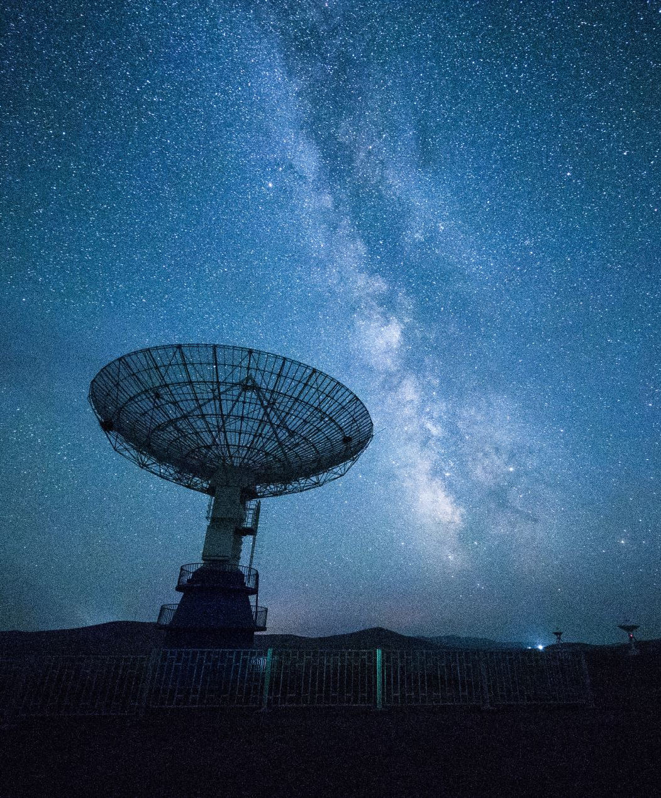
FYP Presentation
Enhancing sdr for satellite ground station with continuous duplex operation, doppler compensation and several modulation methods
Presented by: Hari prakash kulasekaran

Slide 2
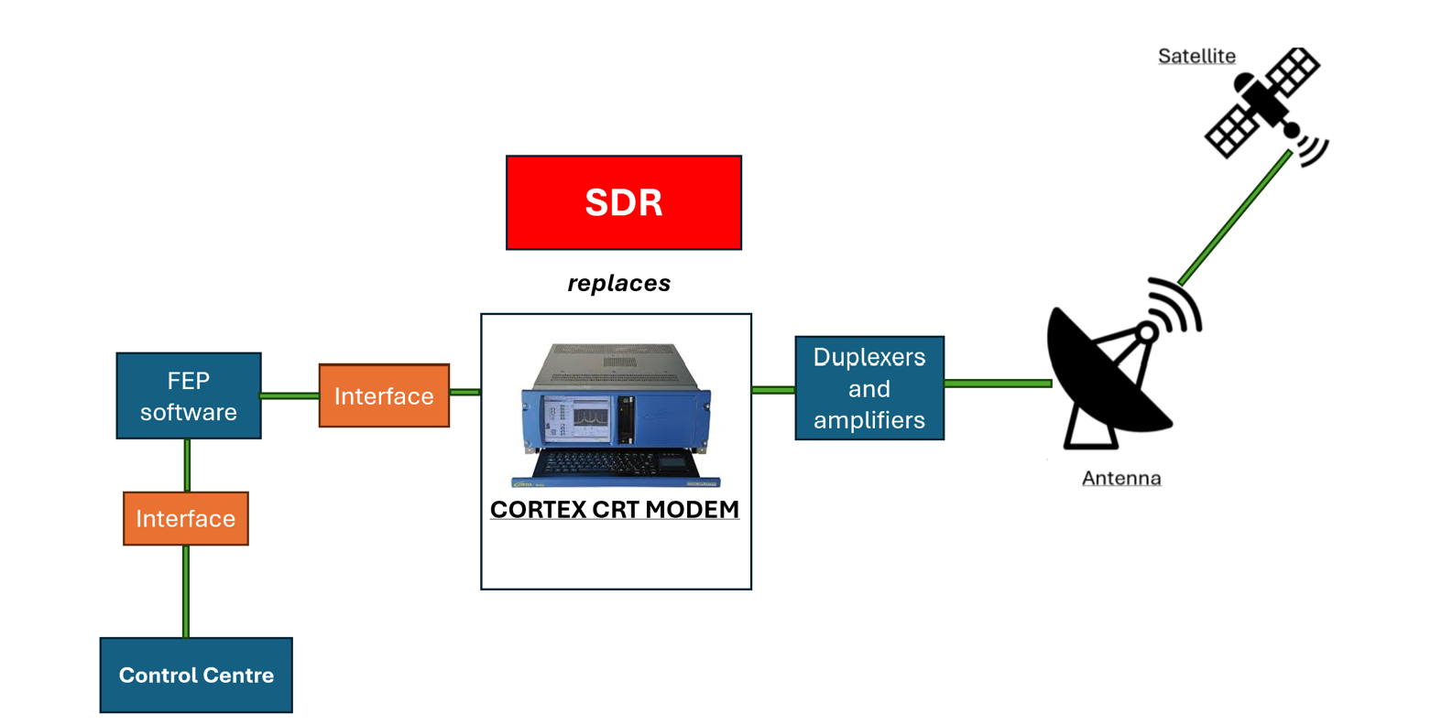
Introduction
Modems
Modulation and Demodulation
Translator between analog and digital devices
SDR
Same functionality through a software setup
Cost efficient and highly portable

Slide 3

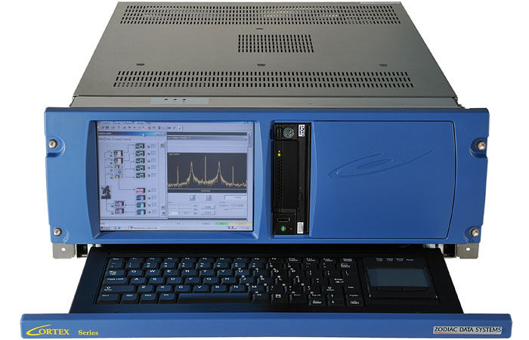
Introduction
Motivations
CORTEX CRT are expensive: $100,000
Reduce the dependence of multiple CORTEX CRTs
SDRs alleviate deployment challenges posed by physical modems at overseas launch sites
Achieve seamless modification and upgrades with SDR

Slide 4

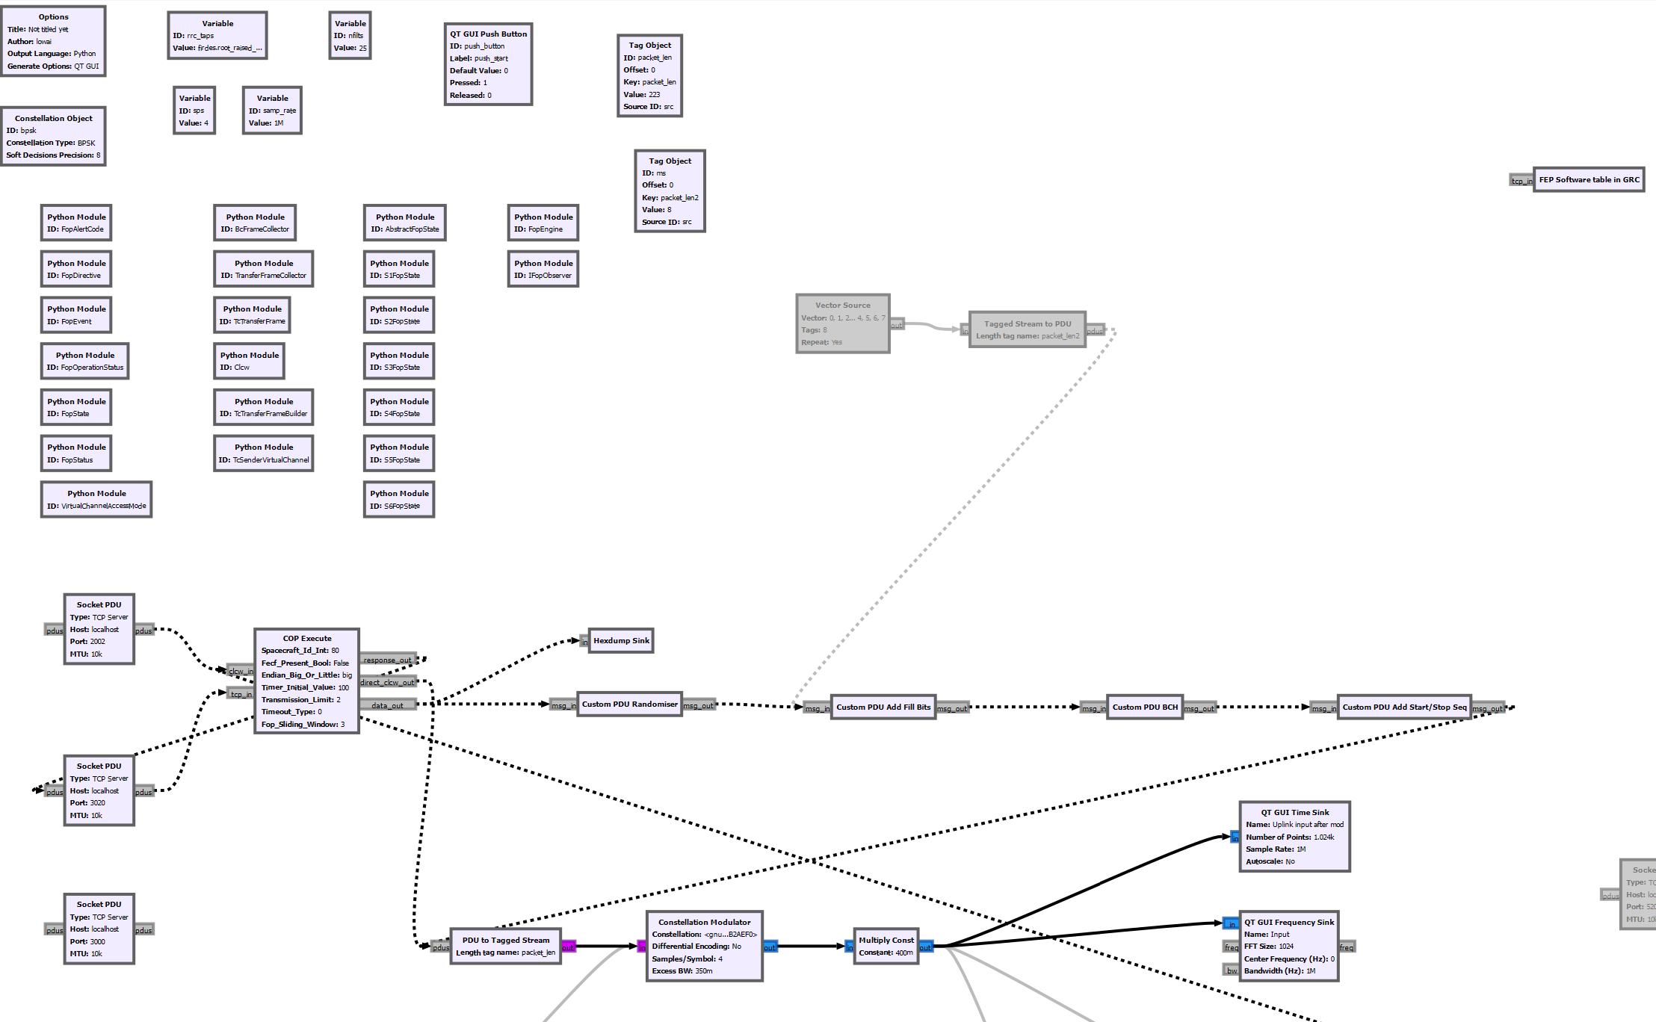
Introduction
Background
Previous student work: Necessary foundation
Extend capabilities of existing GNU Radio-based SDR
GNU Radio: Open source SDR development tool, robust signal processing features
Core objectives
Identify and resolve design gaps
Middleware for integration with existing systems
Doppler compensator and additional modulation methods deprioritised

Slide 5
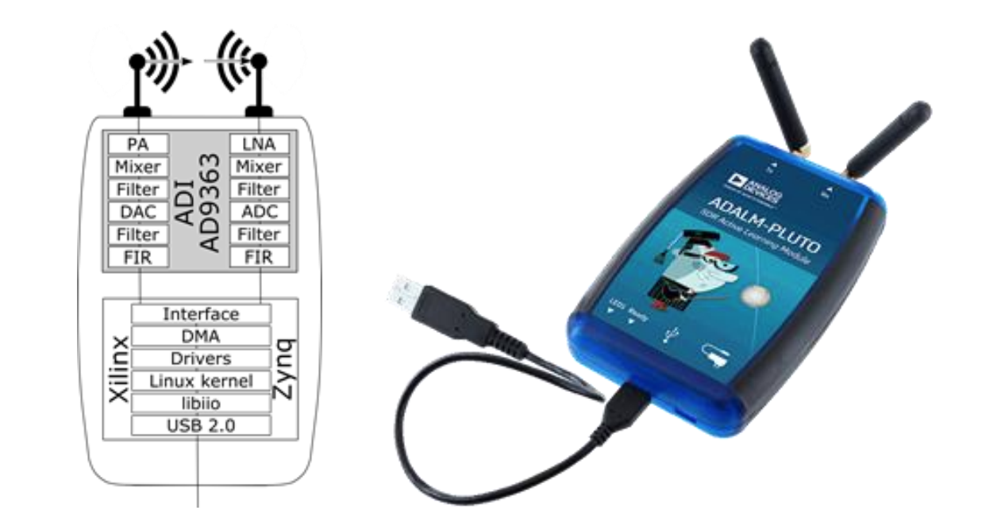
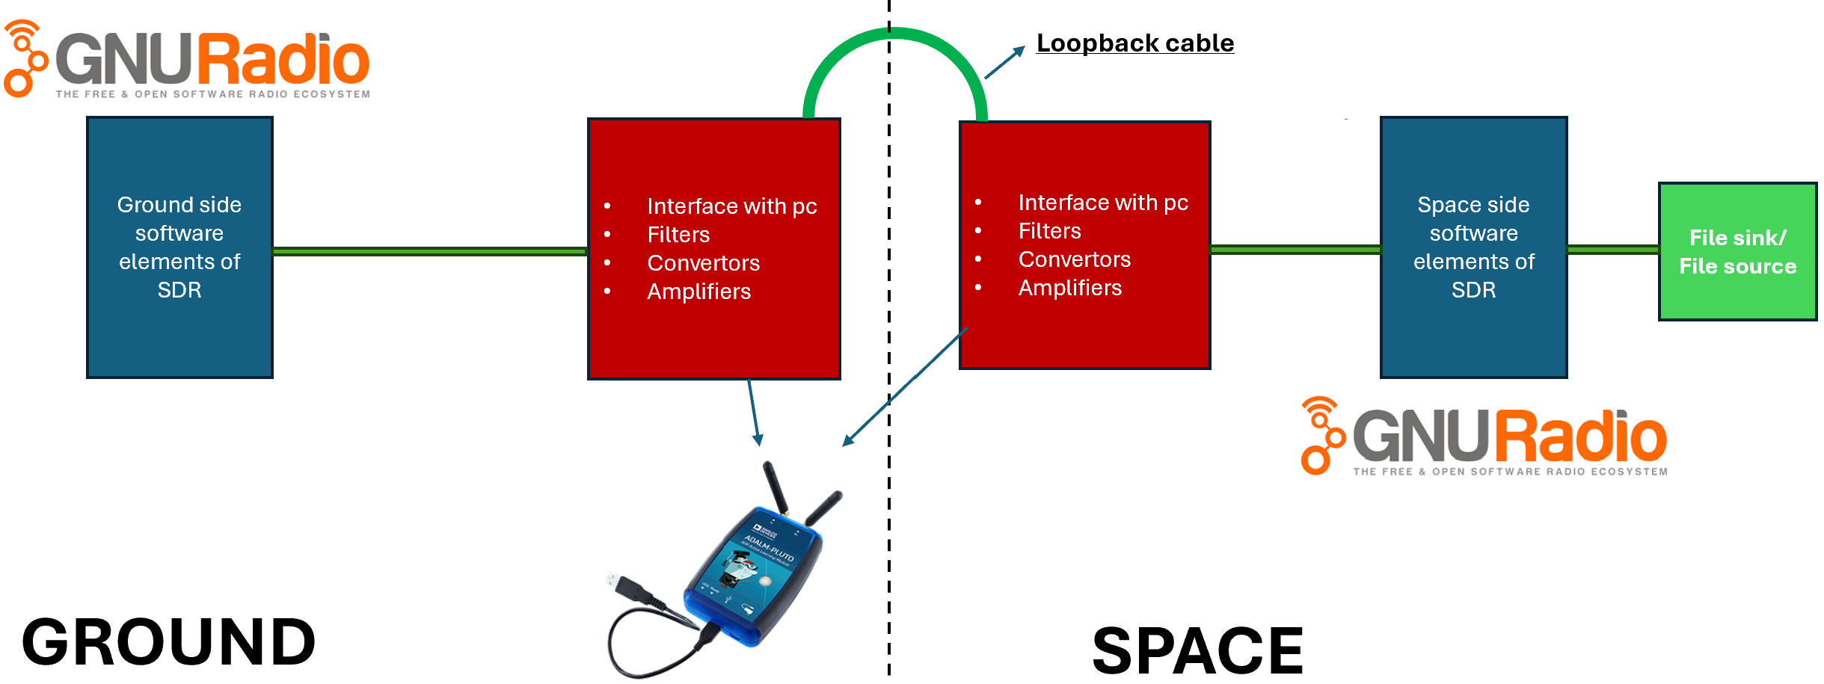
Theoretical framework
Hardware components
ADALM-PLUTO transceiver
Interface and work together with GNU radio
Software components
Telecommand: Uplink of data from ground to space
Telemetry: Downlink of data from space to ground
In-compliance to CCSDS protocols

Slide 6
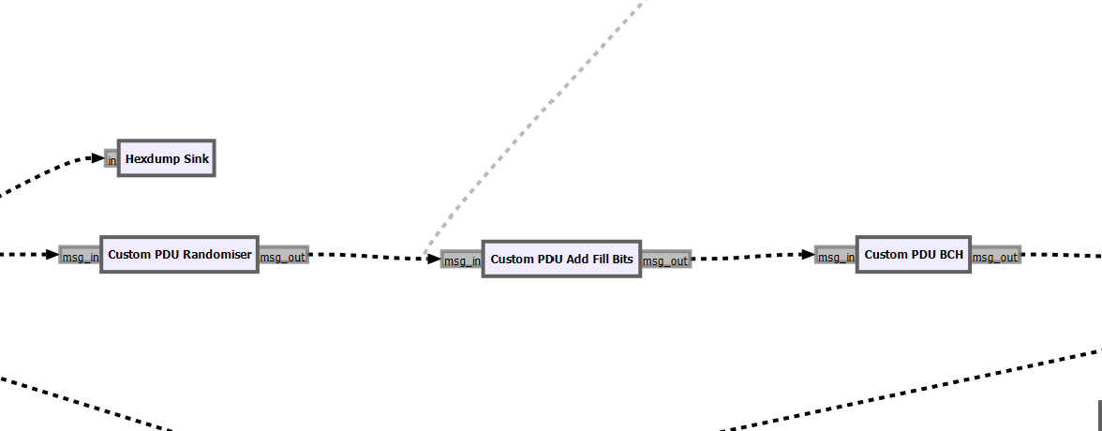
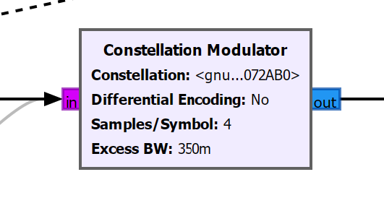
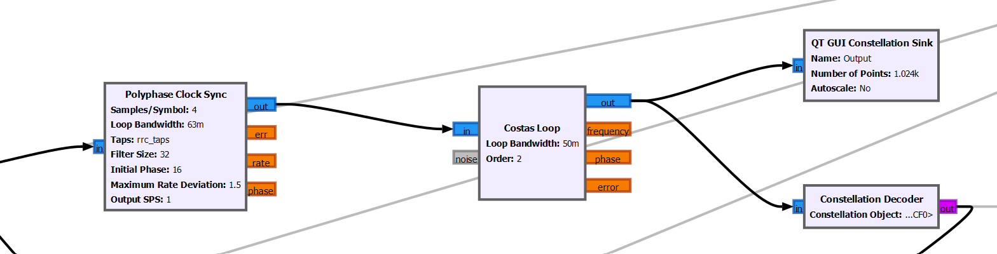
Theoretical framework
Telecommand
Data packeting (Ground)
Bit randomisation, BCH encoding and header-tail tagging
BPSK modulation at 521 kHz
Demodulation and recovery (Space)
Handle clock recovery
Costas loop: Down-convert signal
Constellation decoder: Retrieve original data

Slide 7
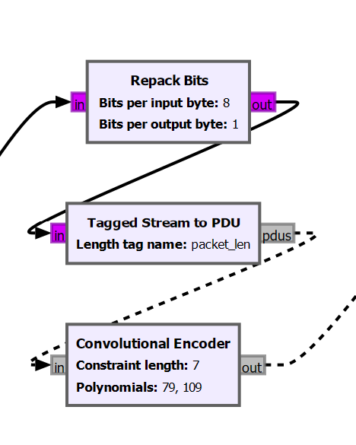
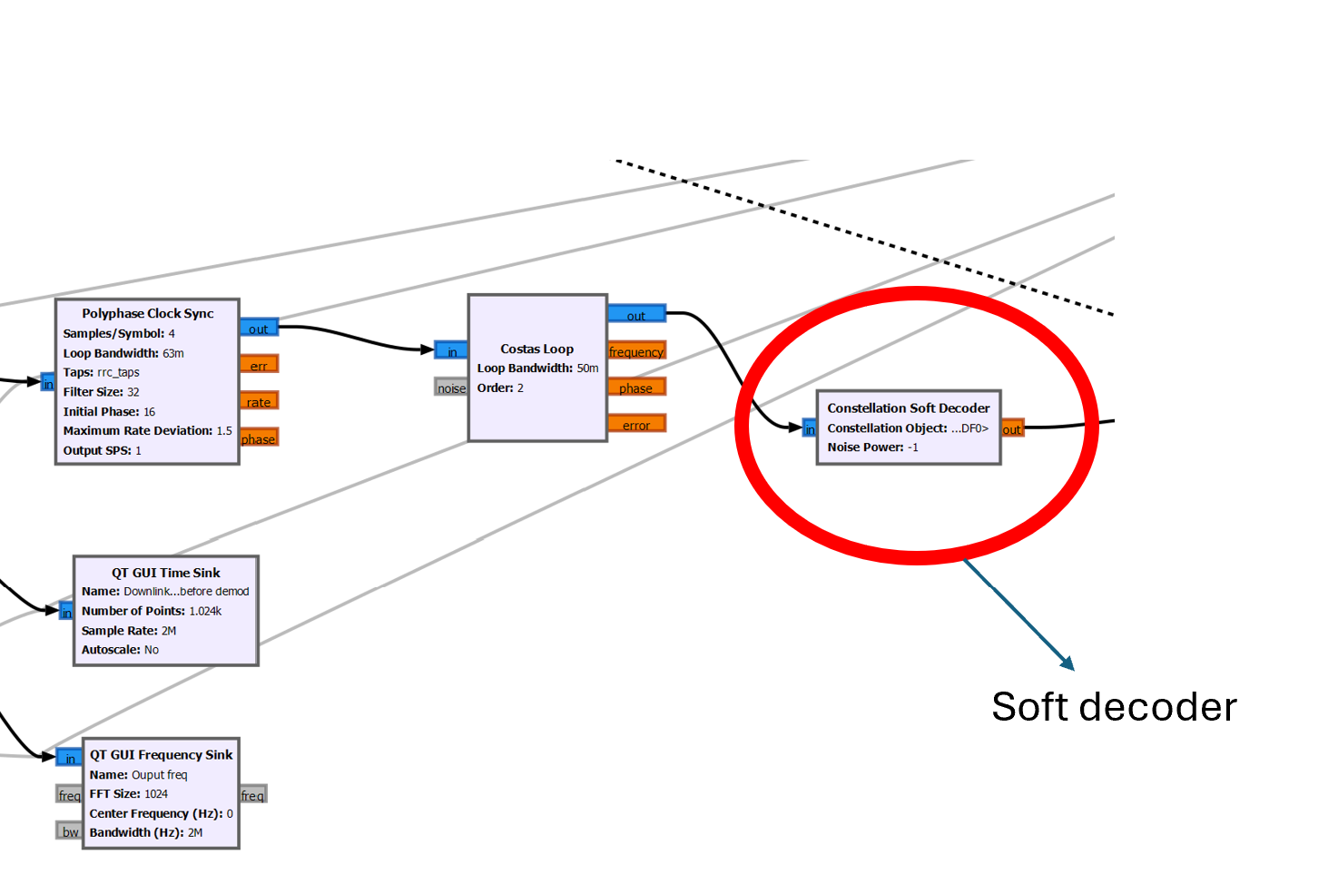
Theoretical framework
Telemetry
Encoding (Space)
Implementing error correction methods( Reed-Solomon Encoding)
Convolutional encoding
Modulation
BPSK modulation
Demodulation and decoding (Ground)
Constellation soft decoder
Viterbi and RS decoding

Slide 8
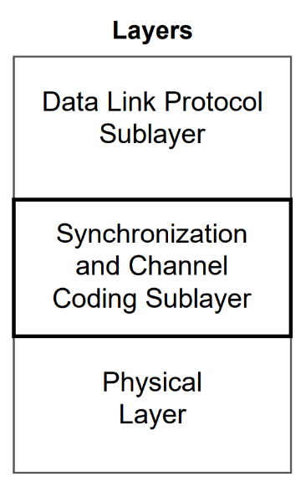
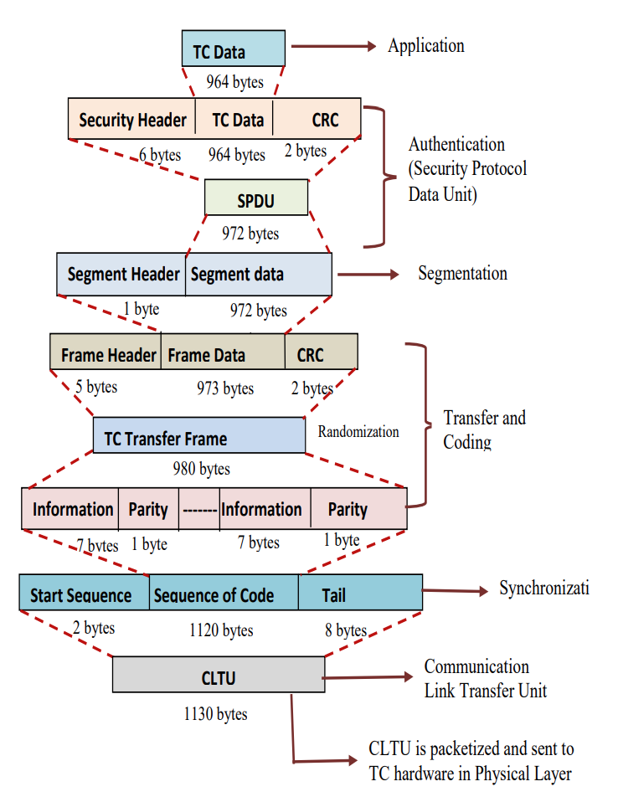
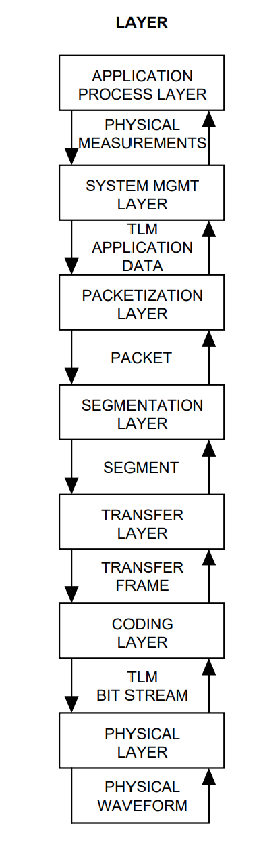
Theoretical framework
CCSDS communication protocols for telecommand
CCSDS communication protocols for telemetry

Slide 9
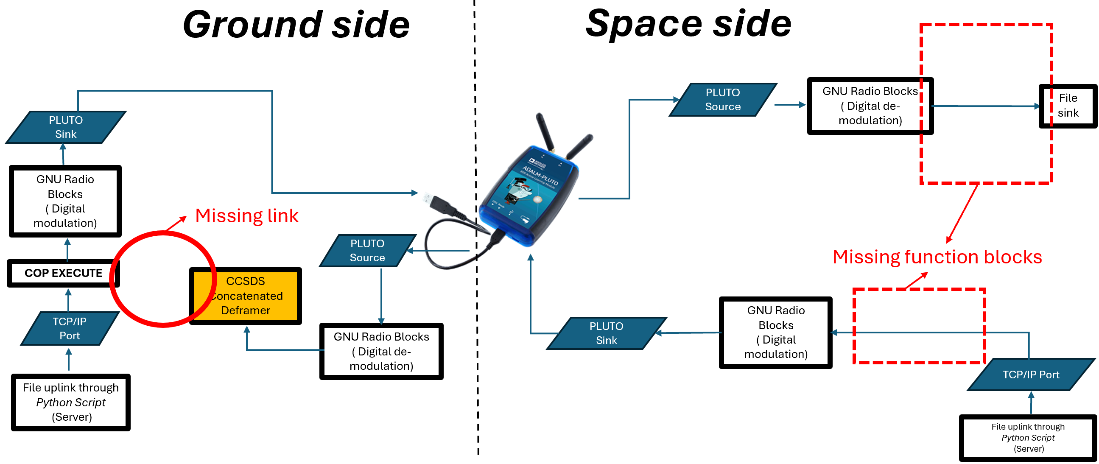
Work done
Identifying design gaps
Unable to achieve 2-way continuous communication
Requires manual intervention for operation
Incomplete telecommand design
Focus areas
Space side telemetry and telecommand
Focus areas

Slide 10
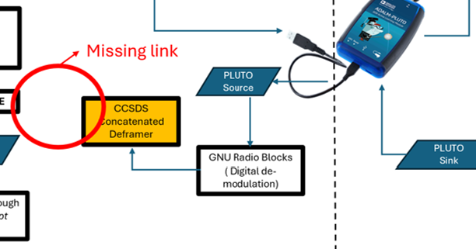
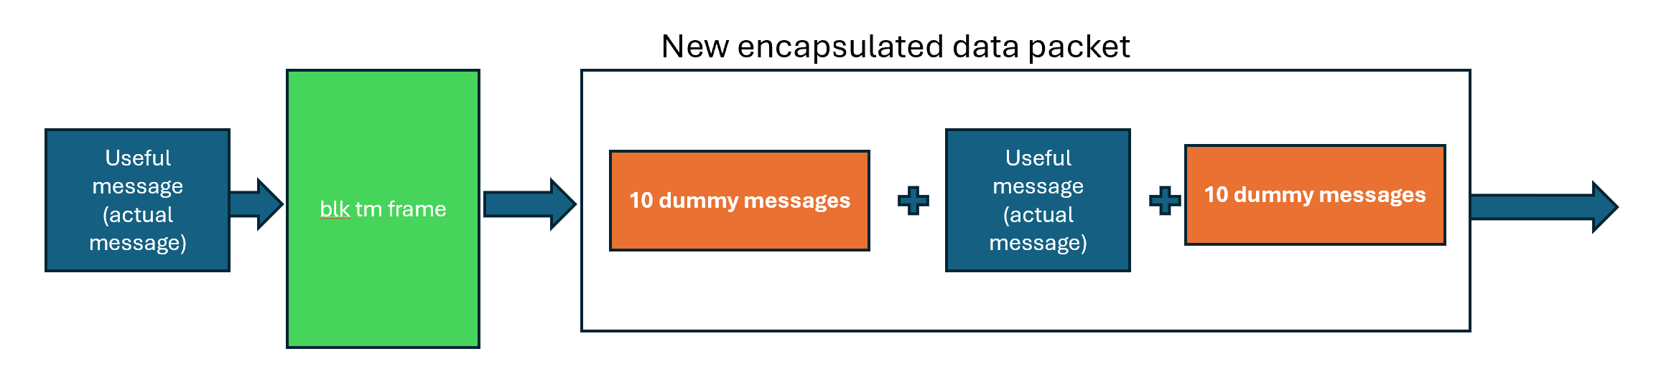
Work done
Upgrading telemetry design
Initial challenge
Deframer deactivates without continuous input
Manual intervention required to repeatedly send identical message
Solution overview
Introduced “BLK TM Frame” GNU Radio block with encapsulation logic
Actual data + 10 dummy packets before and after
Mimic a continuous stream

Slide 11
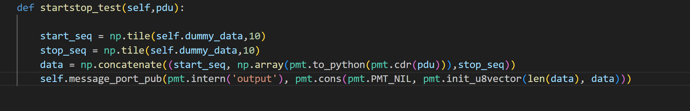
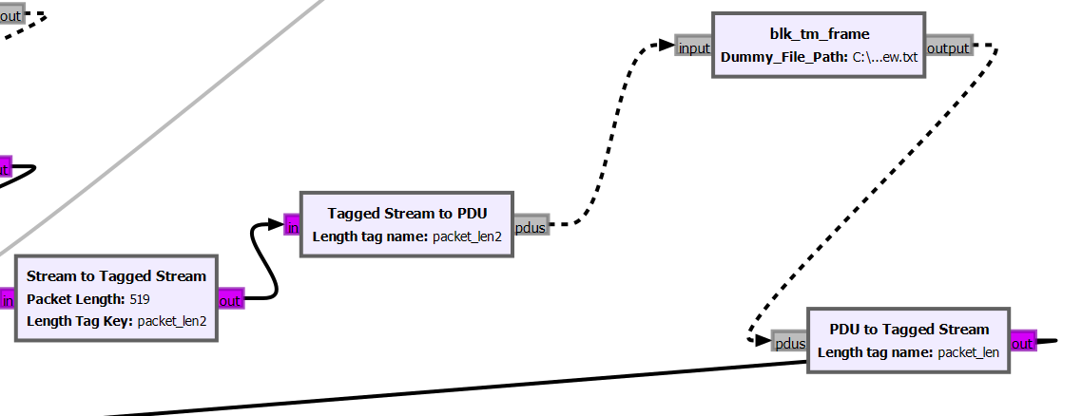
Work done
Integration details
Custom python script
Message encapsulation
Message boundary framing
Data convertor blocks
Synchronize with original architecture

Slide 12
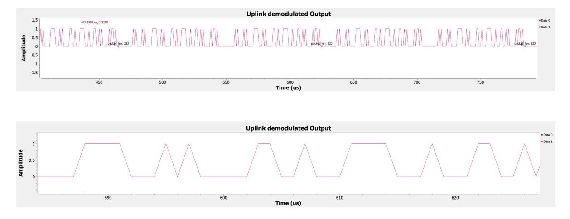
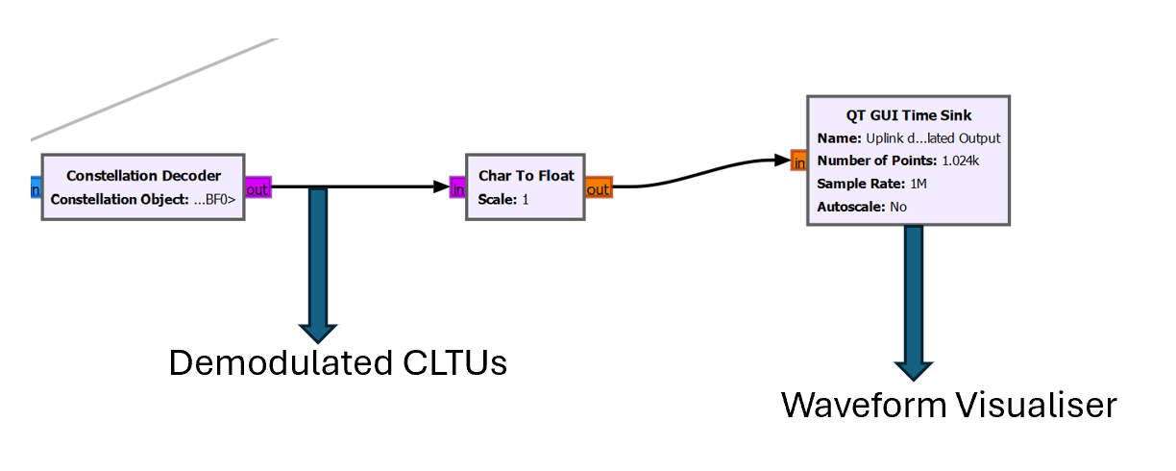
Work done
Upgrading telecommand design of SDR
Initial challenges
Space-side processing stopped at CLTU-level post-demodulation ( highest layer in protocol hierarchy)
Not unpacked to extract original message
Verification through waveform visualisation
Notes:
Finishing touch

Slide 13
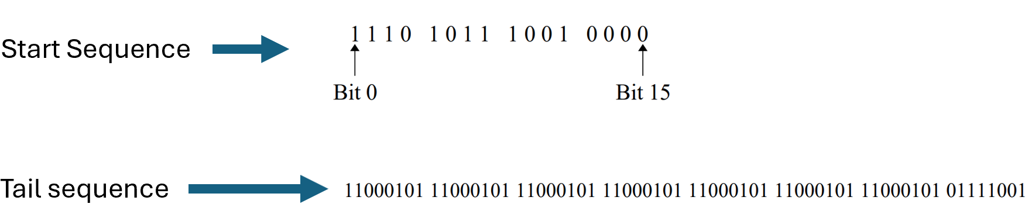
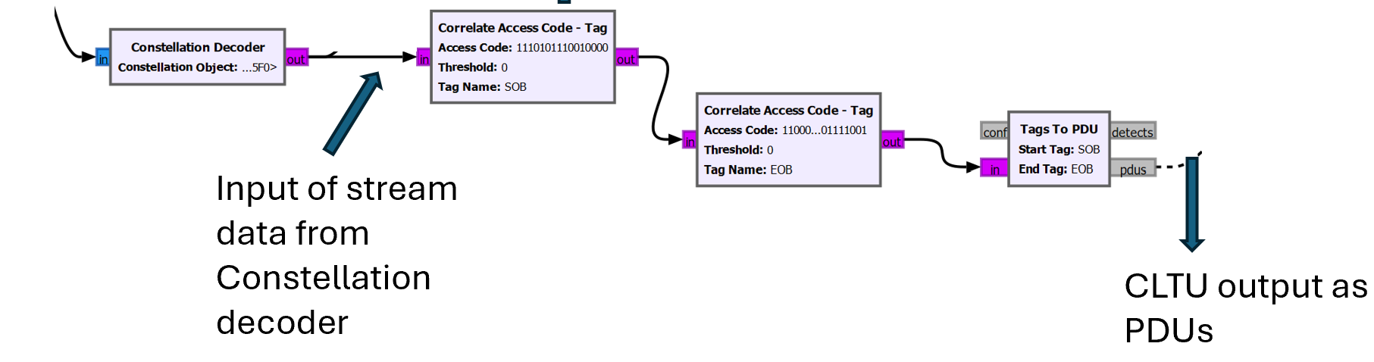
Work done
Integration details
CLTU identification using start and tail sequence
Conversion to PDU format for data handling

Slide 14
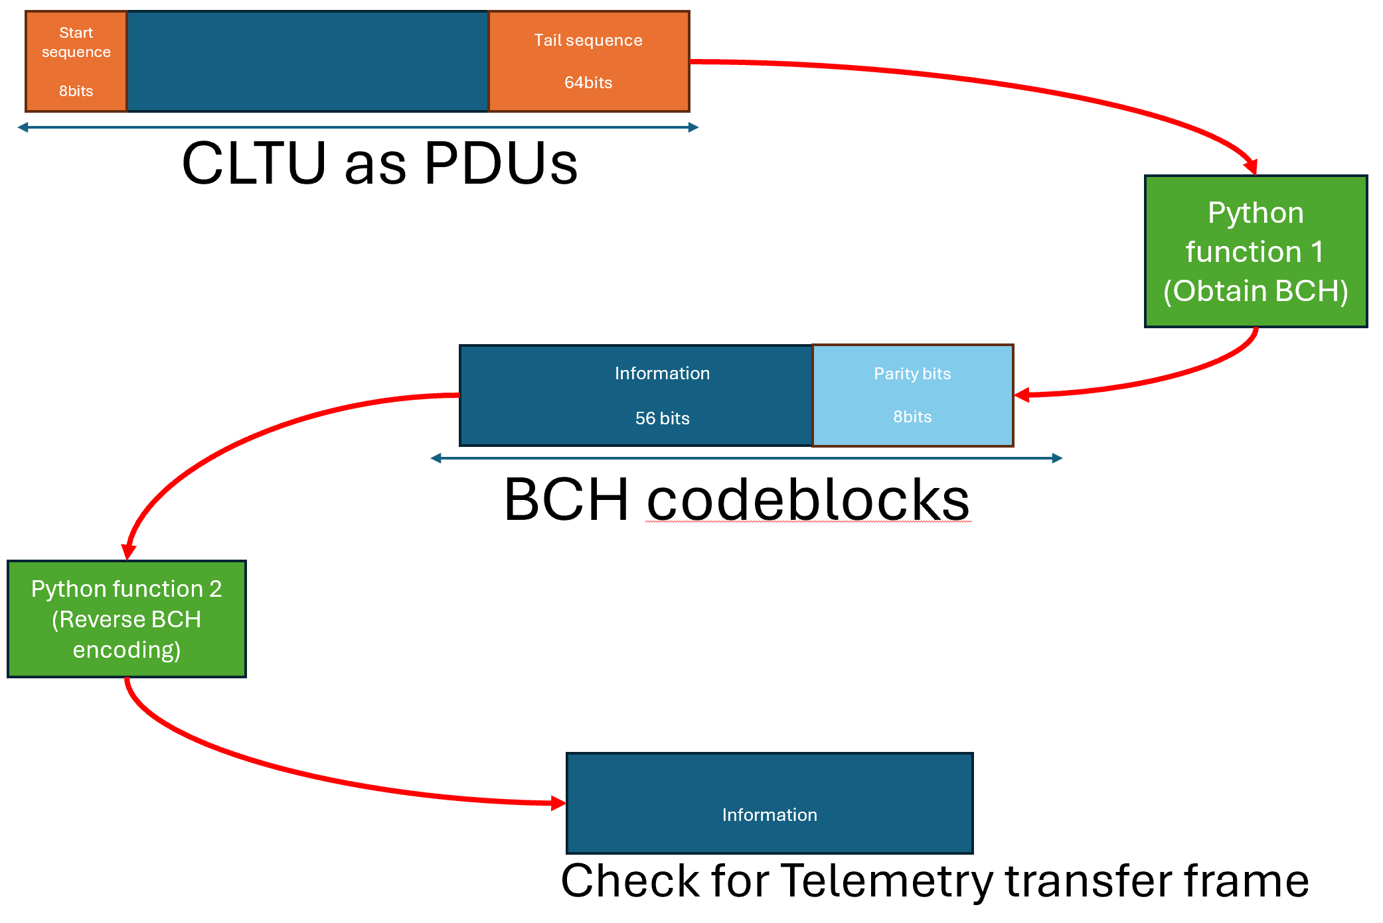
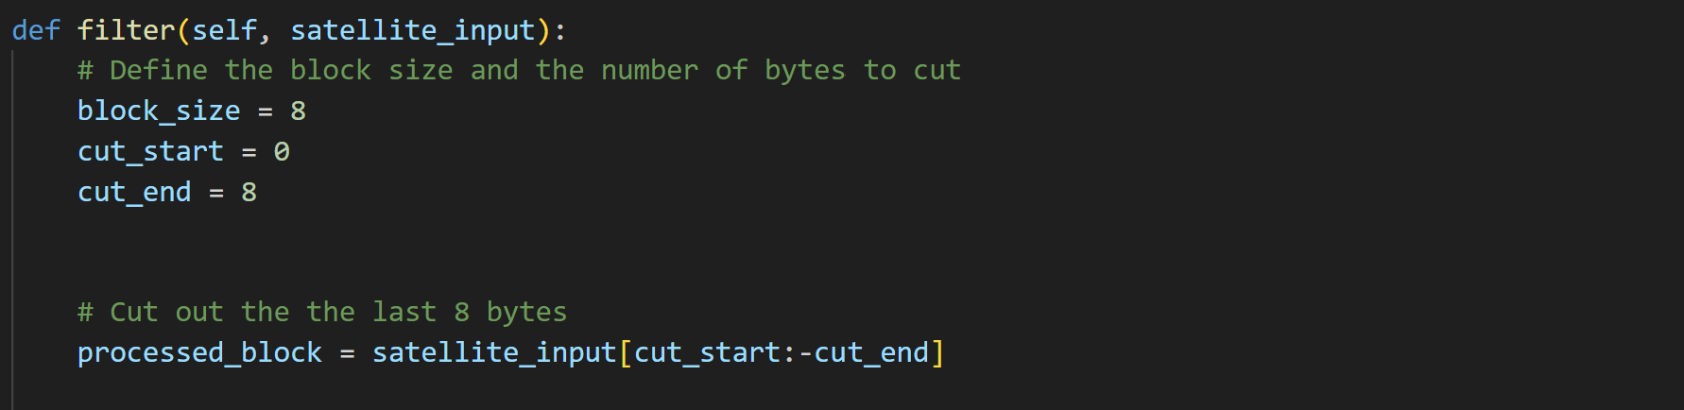
Work done
Integration details
Mock satellite custom python codes
Handle CLTU down-conversion
Segmenting into 8-byte blocks
Appending last byte from BCH codeblocks

Slide 15
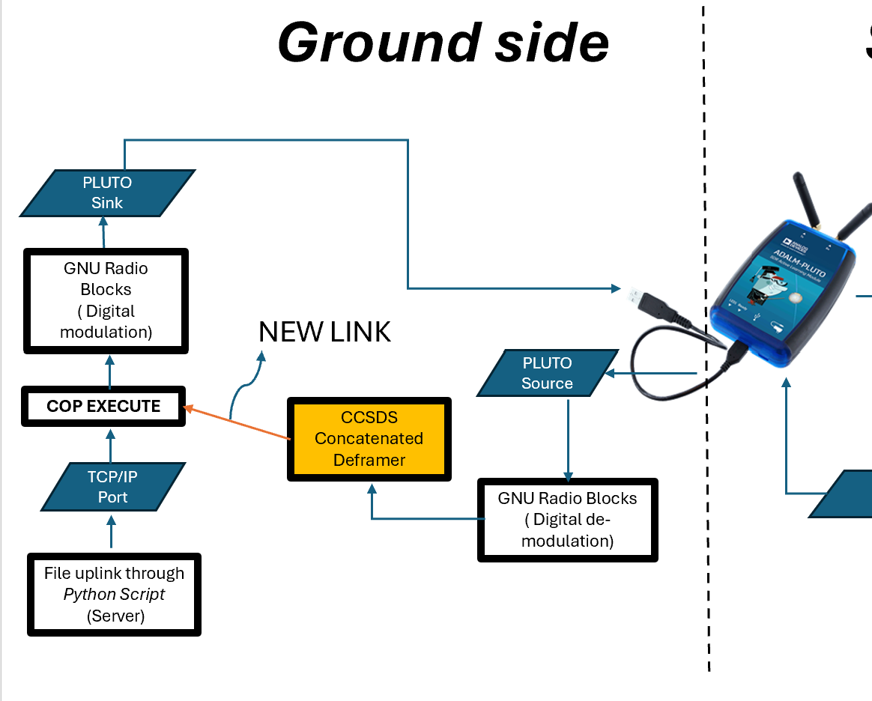
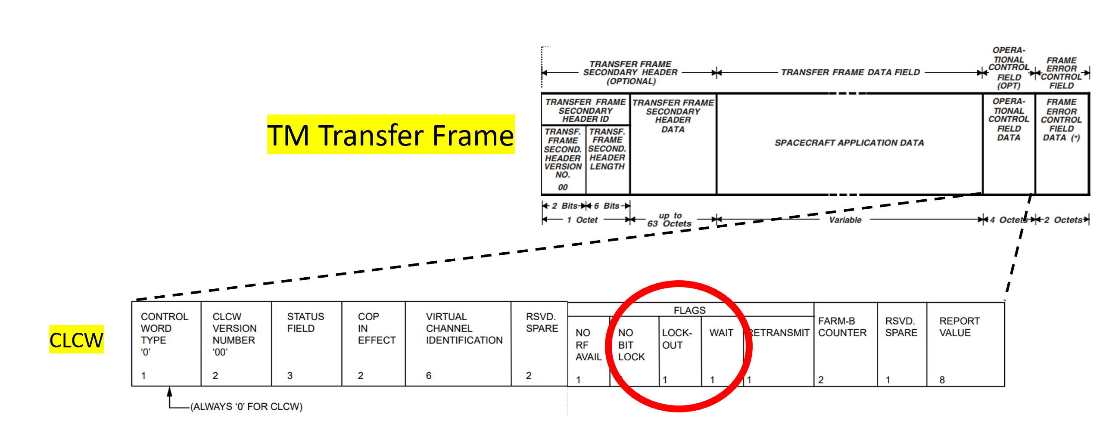
Work done
Final integration
Existing challenge
No link between CCSDS concatenated deframer and COP execute block
Ground station unaware of space side status
Established new link
Telemetry transfer frames can be passed to COP execute
Complete end-to-end communication
Make critical decisions, operate more autonomously and efficiently

Slide 16
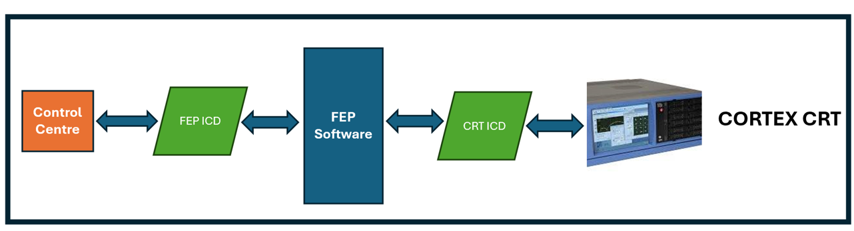
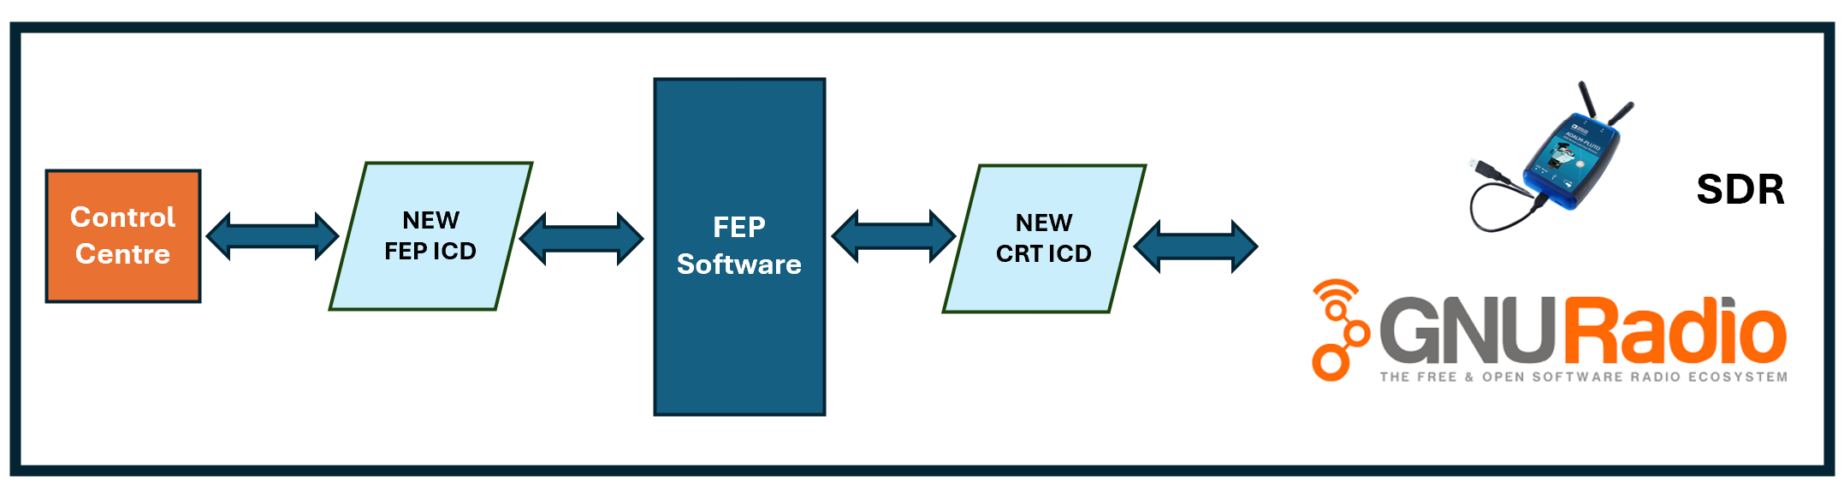
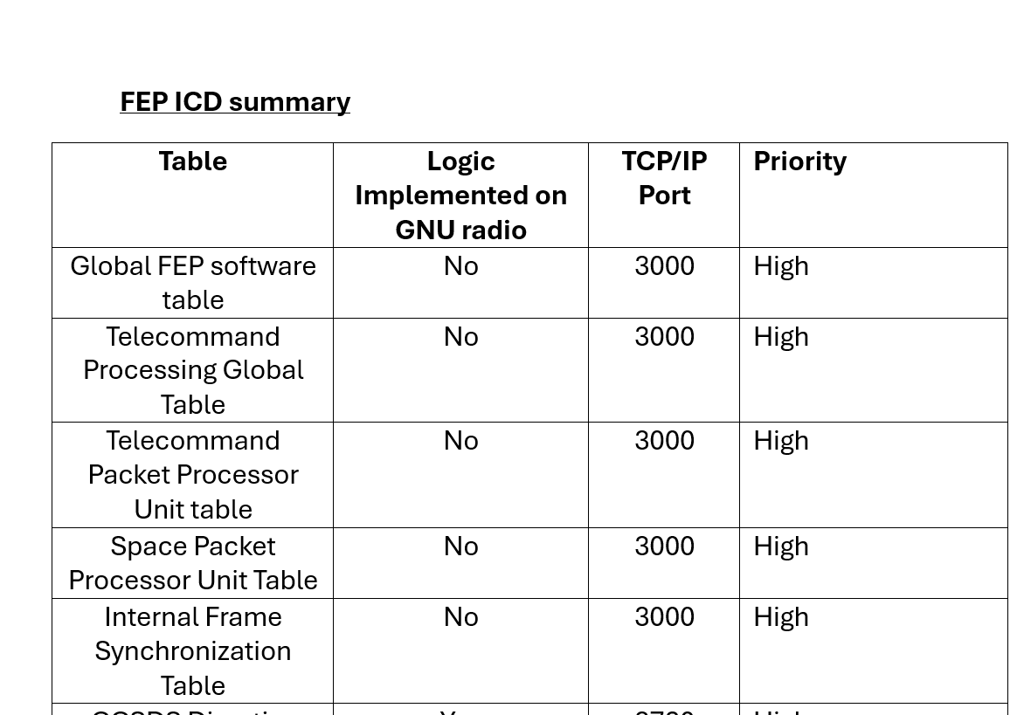
Work done
Implementation of middleware
Replicate FEP/CRT ICD functionalities
Foundational work
Identifying TCP/IP port numbers for each table
Python script for Global FEP software
Replaced with

Slide 17
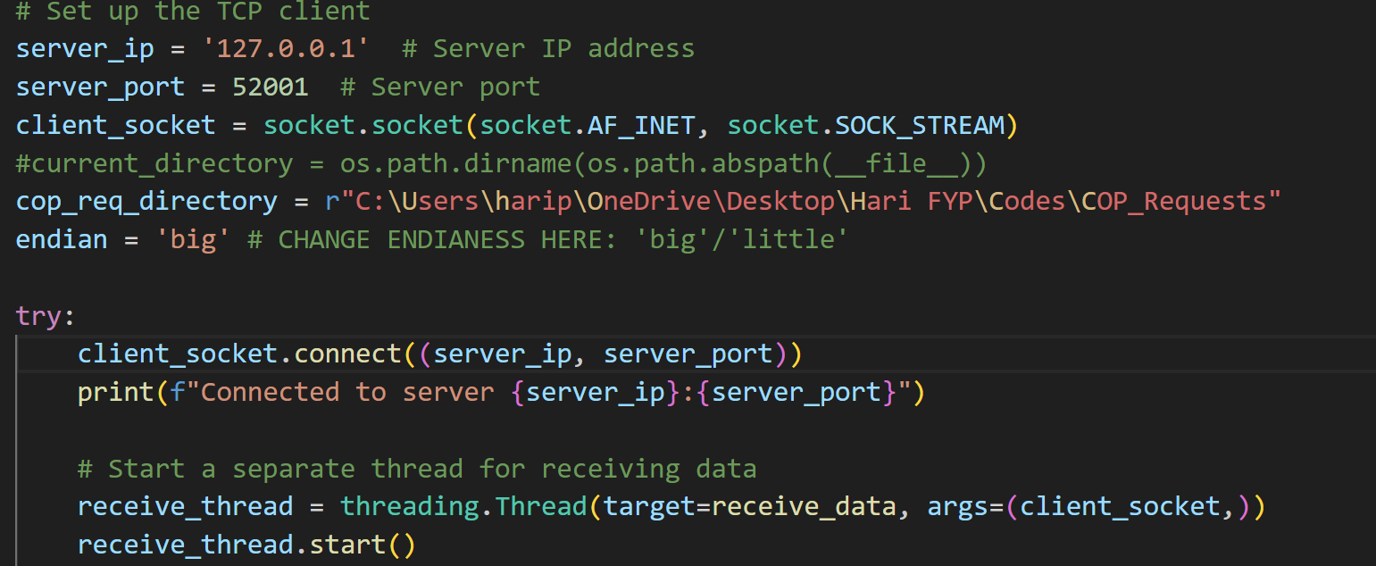
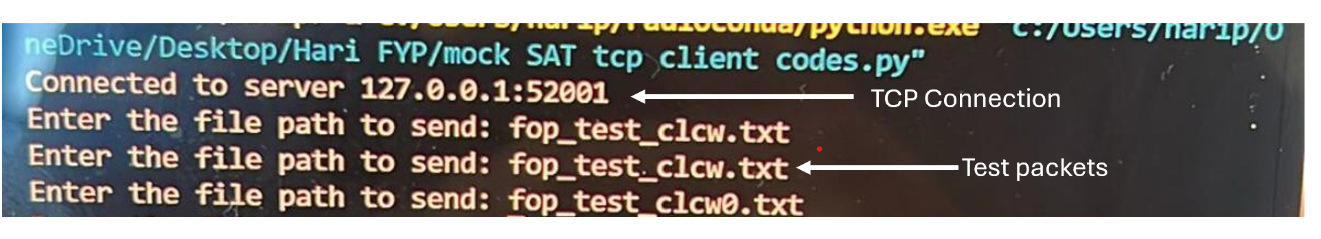
Testing and results
Development of test code
Operates through TCP connection with GNU radio
Client: Python script
Server: GNU Radio

Slide 18
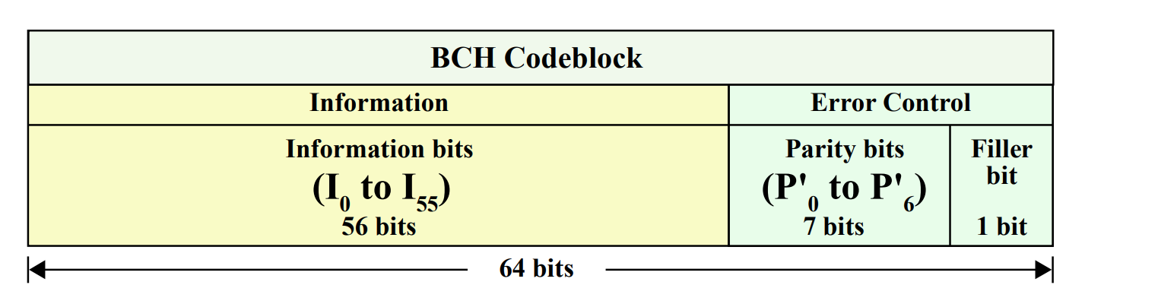
Testing and results
Testing upgraded telecommand design
Feed 8-byte input data through vector source
Total input of 16 bytes of BCH codeblocks
Input data
Encoding
Modulation
Ground side
8 Byte input data
7 Byte input data
1 Byte input data
6 Byte filler data
7 Byte input data
1 byte parity
1 Byte input data
6 Byte filler data
1 byte parity

Slide 19
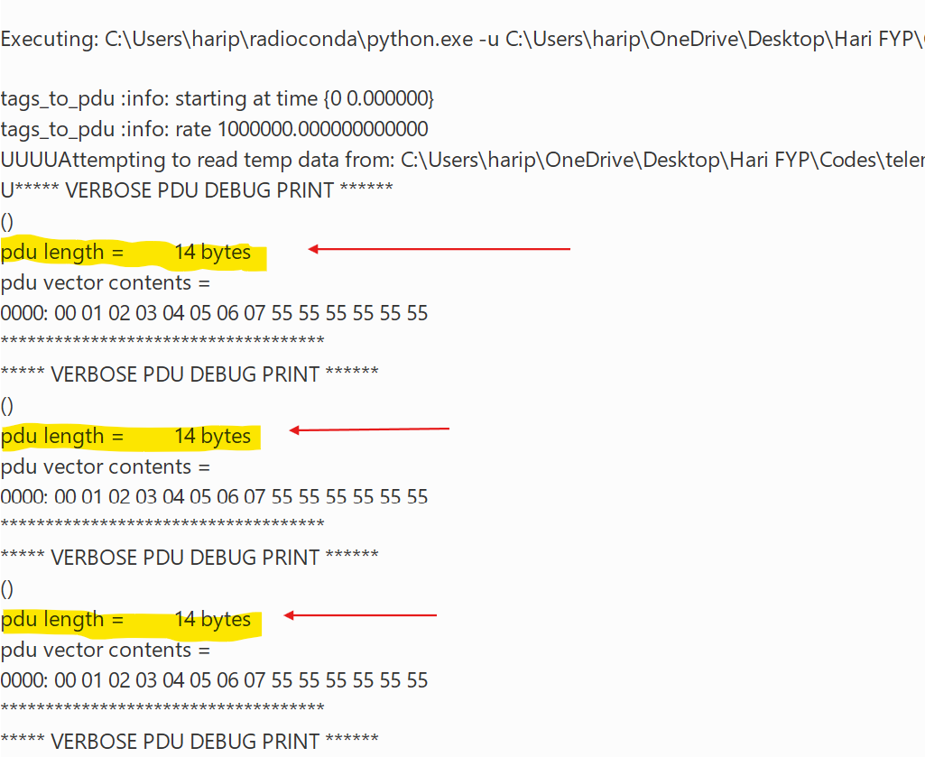
Testing and results
Received data
Decoding and demodulation
Newly added functions
Space side
Testing upgraded telecommand design
Expected output 14 bytes after decoding
Output data

Slide 20
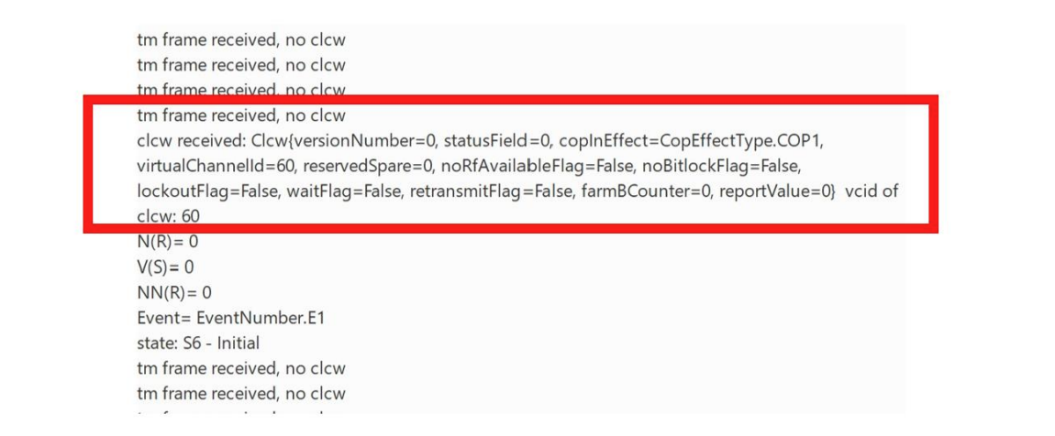
Testing and results
Testing upgraded telemetry design
Space side: Send TM Transfer frame
Ground side: Check if actual data was retrieved from encapsulated message
Input data
Encoding
Newly added functions
Space side
Modulation
Received data
Decoding and demodulation
COP Execute
Ground side

Slide 21
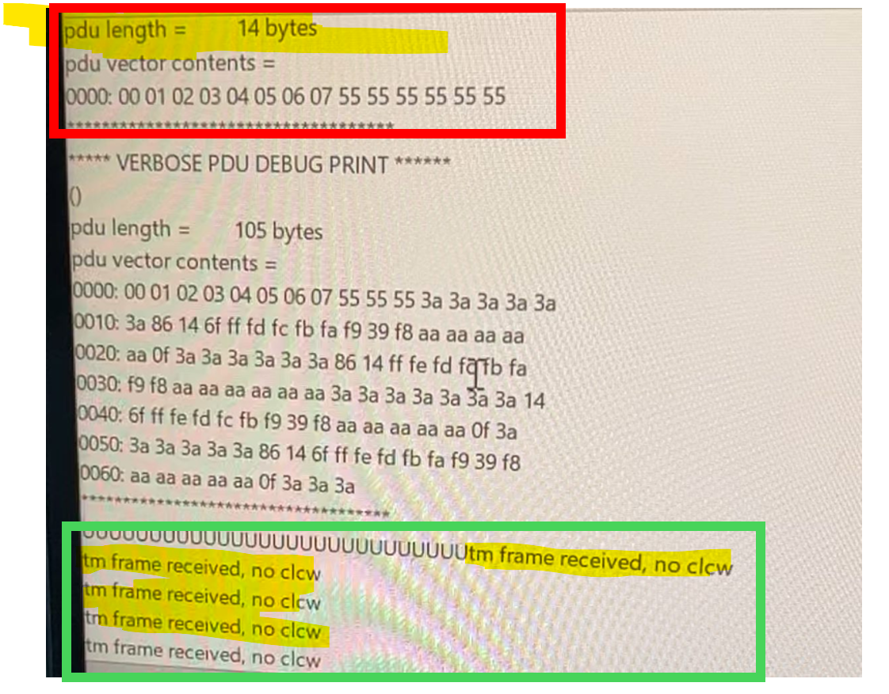
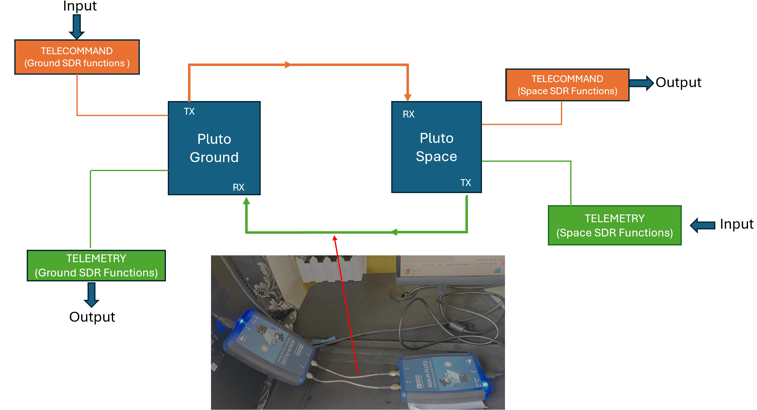
Testing and results
Testing 2-way communication
Configure 2 separate PLUTO devices
Telemetry: TM transfer frame
Telecommand: 14 byte data

Slide 22
Conclusion and future work
Enabled simultaneous 2-way communication through functional blocks
Telecommand design
Down-convert CLTUs to a lower level
Alleviate dependence on waveform
Telemetry design
Resolve deframer deactivation challenge
Operate continuously and no manual efforts needed
Critical information can be passed back to COP Execute block closing the loop

Slide 23
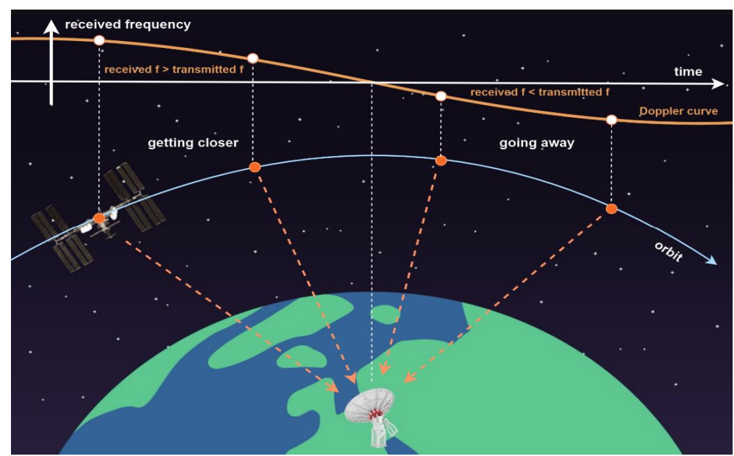
Conclusion and future work
What has been achieved?
More autonomous and efficient operation
Reduced manual intervention
Simultaneous and 2-way communication
Scope for future work
Doppler compensator
Completion of all ICD tables
New modulation methods (PLOP)

Slide 24

Learning points
Hands-on experience in space communication systems and protocols
Handling a technical project autonomously
Learning new software tools and improving python skills
Strong debugging and problem solving skills
Collaboration with industry and project supervisors
Major milestone in academic and professional growth

Slide 25
Thank you for your attention

